Slide 1

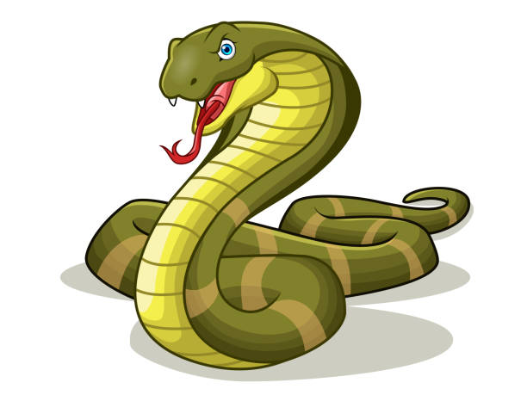
Snake Game with Pygame
An Overview of the Snake Game Implementation

Slide 2

Introduction
The Snake game is a simple arcade-style game where the player controls a snake to eat food and grow longer. The goal is to avoid running into the snake's own body.
• The game becomes progressively more difficult as the snake grows longer.
• The game ends when the snake collides with itself.

Slide 3
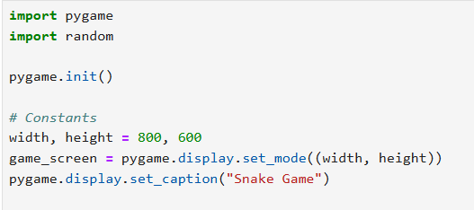
Choose a theme
The game starts by initializing the game window, defining the screen size, and placing the snake in the center. The food is randomly placed within the game area.
• Snake starts at the center of the screen.
• Food is randomly placed on the screen.
Game Initialization

Slide 4

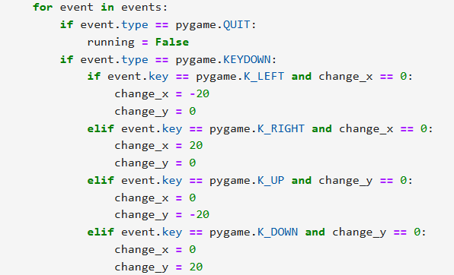
Game Control
Player input is handled through the keyboard. The arrow keys control the direction of the snake's movement. The snake can move up, down, left, or right.
• Arrow keys: control the snake’s direction.
• The snake cannot reverse direction immediately.

Slide 5

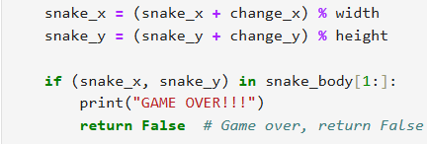
Snake Movement and Collision
The snake moves continuously in the direction controlled by the player. The game ends when the snake collides with its own body.
• Movement is within screen boundaries.
• Collision with the body leads to game over.

Slide 6

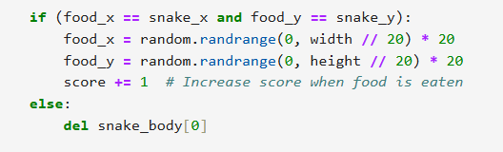
Food Consumption
When the snake eats food, it grows longer, and new food is randomly placed on the screen. The score increases with each food item consumed.
• Food is placed randomly on the screen.
• Snake grows longer with each food consumed.

Slide 7

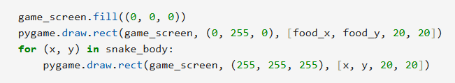
Rendering and Display
Each frame, the screen is cleared, and the snake, food, and score are redrawn. The game speed is controlled by the frame rate, making the movement appear smooth.
• The snake and food are drawn as rectangles.
• The score is updated in real-time.

Slide 8

Game Over
The game ends when the snake collides with itself. A game over message is displayed along with the player's final score.
• Displays the final score when the game ends.
• The game waits for a few seconds before closing.

Slide 9

Conclusion
This basic Snake game demonstrates the fundamental concepts of game development, including handling player input, managing game objects, and rendering updates. Extensions can include adding levels, obstacles, or sound effects to enhance the game experience.

